Slide 1
Web Scraping British airline reviews
Ashley Vizcaino

Slide 2
Table of Contents
Introduction
Sharing Insights
Conclusion

Slide 3
INTRODUCTION
The objective of this analysis is to examine and identify the patterns and trends in customer reviews of British Airlines. This analysis will provide British Airlines with valuable information to improve customer satisfaction, enhance its reputation, and increase customer loyalty.

Slide 4
Sharing Insights

Slide 5
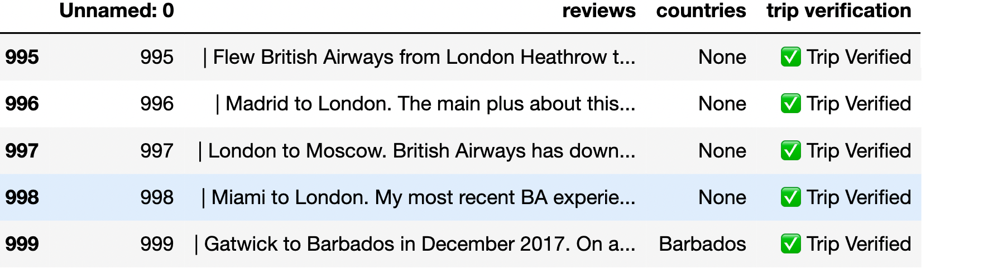
Cleaning Messy Reviews
I scraped reviews of British airlines and had to format them to create readable data.

Slide 6
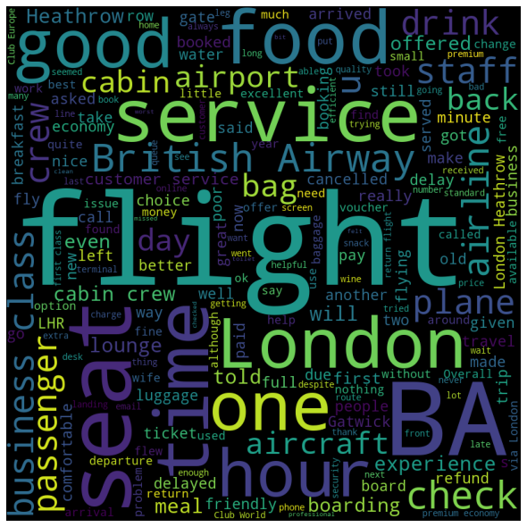
Keywords in reviews
I analyzed the top 10 keywords and additional common words used in reviews and made a Word Cloud.

Slide 7
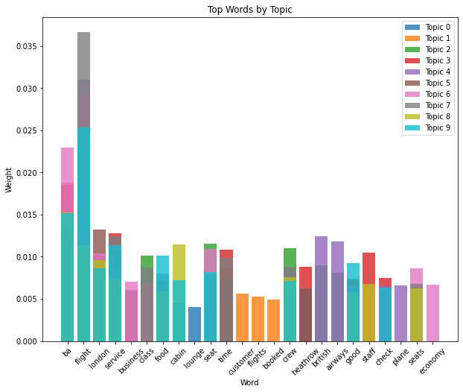
These key words were then generated into subtopics where it is noted which words are used the most and which ones are used the least.

Slide 8
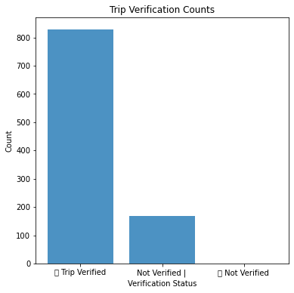
Verification of Reviews
Deciphering whether or not a trip is verified is a large component in the reviews. Most reviews are considered to be verified.

Slide 9
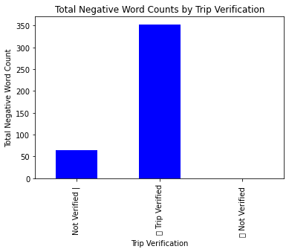
Negative Reviews
I analyzed all reviews for the frequency of being associated with negative keywords such as bad, not good, poor, terrible.
I then connected that to whether or not the account that posted that review was verified.

Slide 10
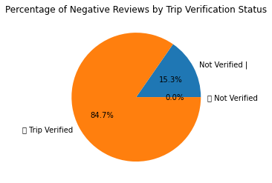
Percentage of negative reviews
On average more reviews that are written by Tryp verified accounts tend to leave negative reviews.

Slide 11
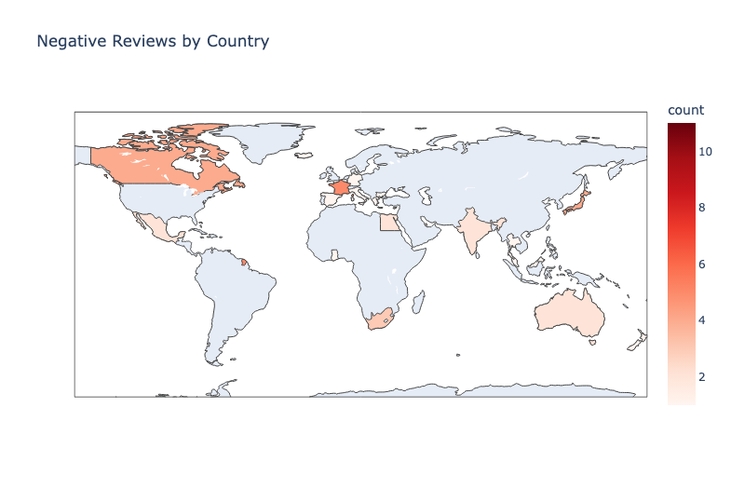
negative reviews By country
Highlighting the different countries that contributed the most negative reviews has been demonstrated here as a heat map.
It is important to find out where these reviews are specifically coming from. This chart shows Singapore was country that contributed highest number of negative reviews, followed by France.

Slide 12
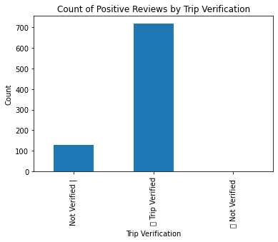
Positive Reviews
I analyzed all reviews for the frequency of being associated with positive keywords such as good, great, excellent, fantastic.
I then connected that to whether or not the account that posted that review was verified.

Slide 13
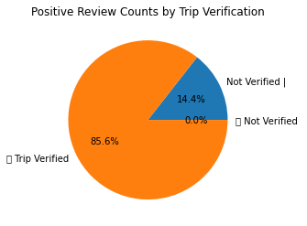
Percentage of Positive reviews
On average more reviews that are written by Tryp verified accounts tend to leave positive reviews.

Slide 14
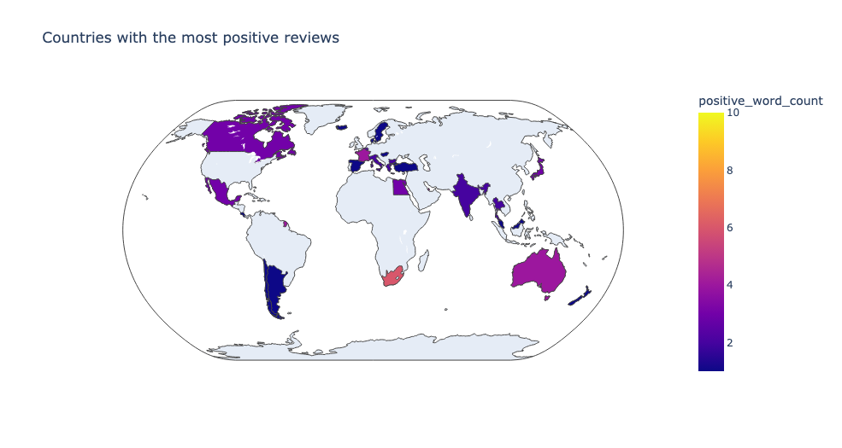
Positive reviews reviews By country
Highlighting the different countries that contributed the most negative reviews has been demonstrated here as a heat map.
It is important to find out where these reviews are specifically coming from. This chart shows Singapore was country that contributed highest number of positive reviews, followed by South Africa.

Slide 15
Key Take AWAYS
The heat maps can be useful in identifying patterns and trends in customer reviews based on geographic locations, which can help the airline tailor its services to different regions.
Trip Verification
Trip verification plays an important role in the credibility of reviews, as the majority of both positive and negative reviews were made by trip-verified accounts.
The most common keywords in the reviews suggest that customers value factors such as flight quality, food, and service.
Airline Service
"Poor" was the most frequently used negative word in the reviews, indicating that the airline should focus on improving this aspect of its service.
Singapore was the country with the highest number of both positive and negative reviews, suggesting that the airline may need to pay extra attention to its services in that region.
Geographical Trends
More Attention towards certain regions
Key value factors

Slide 16
SUMMARY
The analysis of customer reviews of British Airlines revealed key insights that can help improve customer satisfaction and increase loyalty. Out of 1000 reviews, the majority were trip verified, and the top 10 keywords included flight, London, business, class, food, cabin, lounge, seat, BA, and service. Negative reviews were mostly made by trip verified accounts, and the country with the most negative reviews was also Singapore, followed by France. These insights suggest that British Airlines should focus on improving service quality, particularly for trip verified customers, and consider strategies to address common complaints and improve the overall customer experience.

Slide 17
THANK YOU
Ashley Vizcaino
Bluevizcaino@gmail.com

